Slide 1

Department of
DATE
20.08.2020
ELECTRONICS AND COMMUNICATION ENGINEERING

Slide 2
DREAM TEAM
QUICK ORDER
Mr.M.VIVEK KUMAR
ASSISTANT PROFESSOR,DEPARTMENT OF ECE

Slide 3
Team Member’s Details
S.No | Name of the student | Department | Email Id | Contact Number
1 | SHWETHAA G P | ECE | chocosweetygps@gmail.com | 9150670230
2 | DISHA D | ECE | dishadavidpoy@gmail.com | 9788722837
3 | ROOPAK S | ECE | roopakkrishna6571@gmail.com | 6382444425
4 | SOWNDAR K | ECE | sowndarkalimuthu@gmail.com | 9500230050

Slide 4

Problem Statement Description
The way of ordering cans are difficult.
The customers must be in home while delivering cans for paying.
Problems faced by public due to misplacement of order.
Late delivery of water cans

Slide 5
Gap Analysis with current solutions
CURRENT SOLUTIONS
Direct approaching for order.
Placing order through phone calls.
GAP ANALYSED
Not attending the phone calls.
Late delivery.
Forgot order count.
Forgot destination.
Order misplaced.

Slide 6
User friendly software for ordering water cans.
Delivered within time.
Order not misplaced.
Digital Transaction.
Solution

Slide 7

Target Customers ​

Slide 8
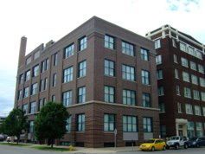
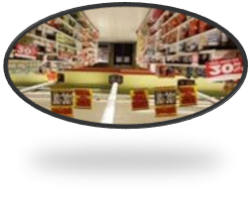




INDUSTRIES AND MNC COMPANIES
HOTELS AND RESIDENCY
SUPERMARKET
HOSPITAL
TEXTILE SHOP
BANK

Slide 9
CUSTOMER VALUE PROPORTION ​
CUSTOMER NEED
Order water cans.
Delivered within time.
Customers need not be available
anytime.
Cash on delivery
VALUE ADDED TO CUSTOMER
Order water cans.
User friendly interface.
Digital payment.
24/7 customer access.
Coupons and Offers.

Slide 10


Uniqueness/Key feature
Digital transaction
Delivery within time
Cash on delivery
Easy to use
Tracking
Coupons and offers
A.I

Slide 11
STAGE 1
Found the problem and then its solution.
STAGE 2
Found the platform Android studio to develop an app.
STAGE 3
Started to learn JAVA language and XML.
STAGE 4
Completed frontend Designing.
PROCESS FLOW DIAGRAM

Slide 12
PROCESS FLOW DIAGRAM
STAGE 5
Want to write backend coding.
STAGE 6
Test and Debug an app.
STAGE 7
Trial and error checking an app with companies and customers
STAGE 8
Launch an app.

Slide 13
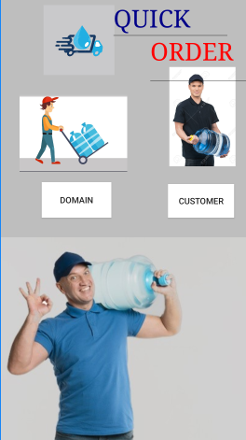
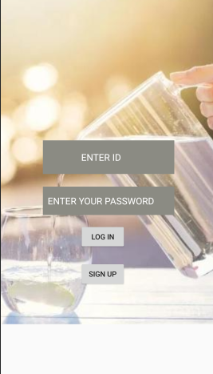
Prototype of
application

Slide 14

MARKET OF OUR SOFTWARE
After few years we will tie up with 100+ companies.
We will earn profit by selling the software to companies.
For each and every transaction we will get some percentage commission as profit.

Slide 15


